Slide 1
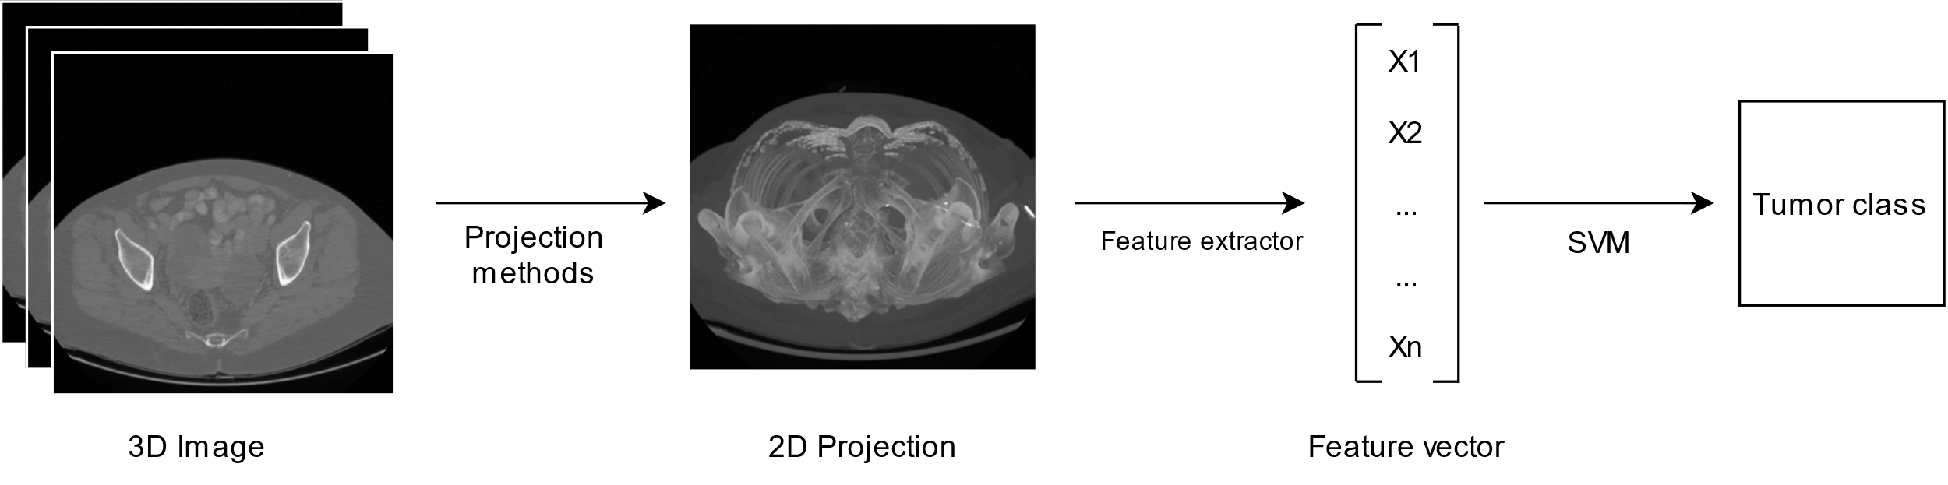
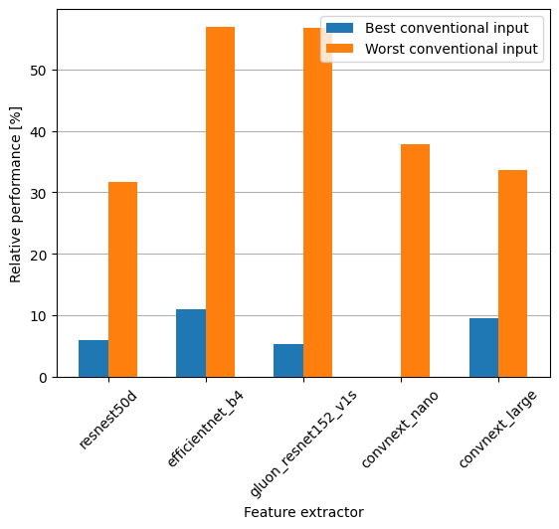
Variable input on 3 channel feature extractors, the solution which will make doctors obsolete?
Sven Bierenbroodspot
Figure 1: Methods
Results
Figure 2 shows the relative performance of the best input configuration compared the both the worst and the best scoring conventional input. The obtained results are inconsistent. One feature extractor is able to reach more than 10% better performance using a variable input compared to the best conventional input method. Another one is not able to reach any improvement using the variable input. The improvement compared to the worst conventional input is never below 30%.
Introduction
Ovarian cancer, often diagnosed late, claims over 14,000 lives annually. Radiographic imaging, including CT and MRI scans, aid doctors with tumor classification in order to reach high accuracy. Inspired by successful AI applications in lung cancer, this study explores the applicability of AI techniques, specifically 2D CNNs, in ovarian cancer classification. This study concerns variable inputs for the feature extraction using 2D CNNs.
Methods
The 3D images are obtained from the Catharina hospital in Eindhoven. These images contain a tumor outline as well as a label.
For the projection methods there are 5 different projections to be considered; Maximum intensity projection, average intensity projection, minimum intensity projection, a slice at the height with the largest part of the tumor, and the maximum intensity projection of only the tumor.
The 2D projections are used as input for the feature extractors. The conventional input for a 3-channel 2D CNN feature extraction for medical images is to copy the only channel 3 times. With variable input the aim is to give the neural network more information in the form of different projections of the same image.
To evaluate these feature extraction results a simple SVM is trained 100 times and the best AUC considered as the resulting score for the feature extraction.
Figure 2: Relative performance of the best input configuration
Conclusion
There are improvements to be made when considering variable input configurations compared to conventional inputs. However, it is not guaranteed to improve results. In order to obtain the best results, all the configurations have to be considered. For now the results are not convincing enough to replace the doctors at the hospital, but in combination with other techniques it is bound to change sooner rather than later.
DEPARTMENT OF ELECTRICAL ENGINEERING

